Slide 1

기계학습과 응용
Group 10
김상훈 변상준 심재헌 정희명

Slide 2
Index
Idea
Method
Modeling
Conclusion
Disccusion

Slide 3

Idea

Slide 4
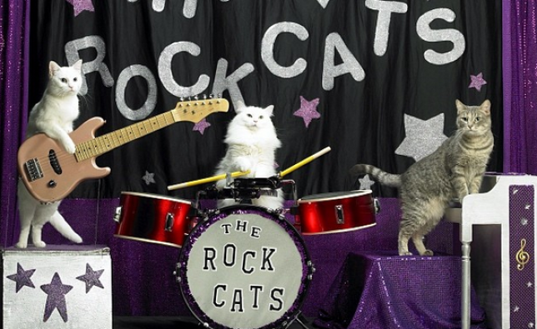
Idea
What’s our goal?
cat
cat
playing
playing
cat
guitar
piano
drum
playing

Slide 5
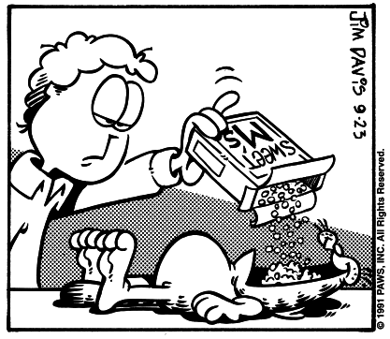
Man
Cereal
Object Detection
1. Man
2. Cereal
3. Cat
Cat

Slide 6
Action Detection
Eating
1. Eating

Slide 7
Man
Cereal
Result
Eating
1. Man
2. Cereal
3. Cat
4. Eating
Cat

Slide 8
Man
Cereal
Grouping
Eating
1. Man
2. Cereal
3. Cat
4. Eating
Cat

Slide 9
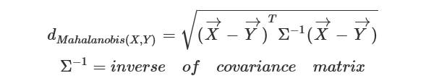
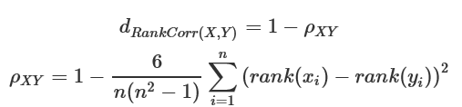
Method
K-Nearest Neighbor(KNN)
Man
Cereal
Eating
Cat

Slide 10
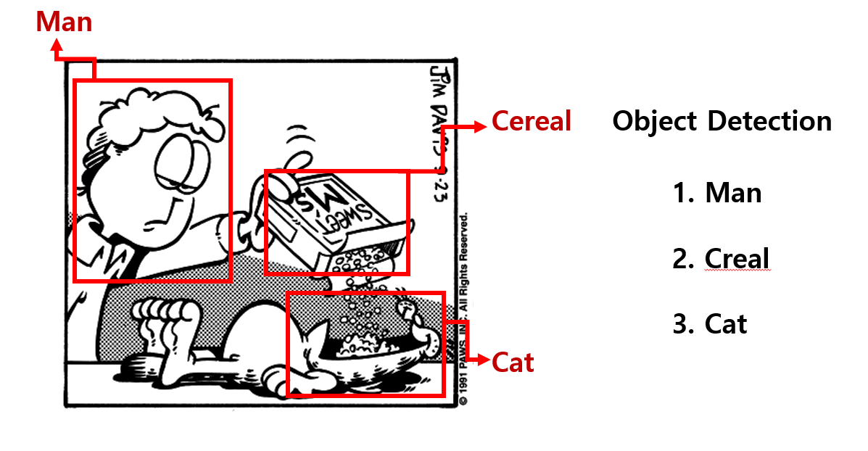
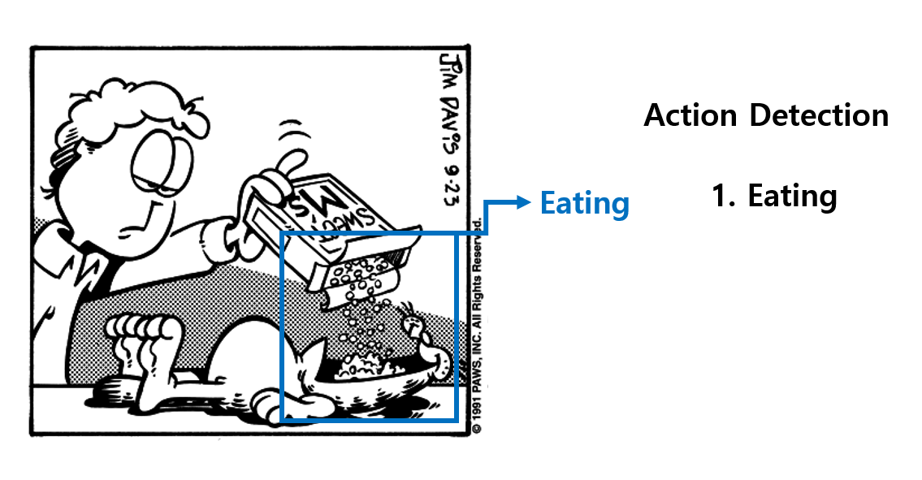
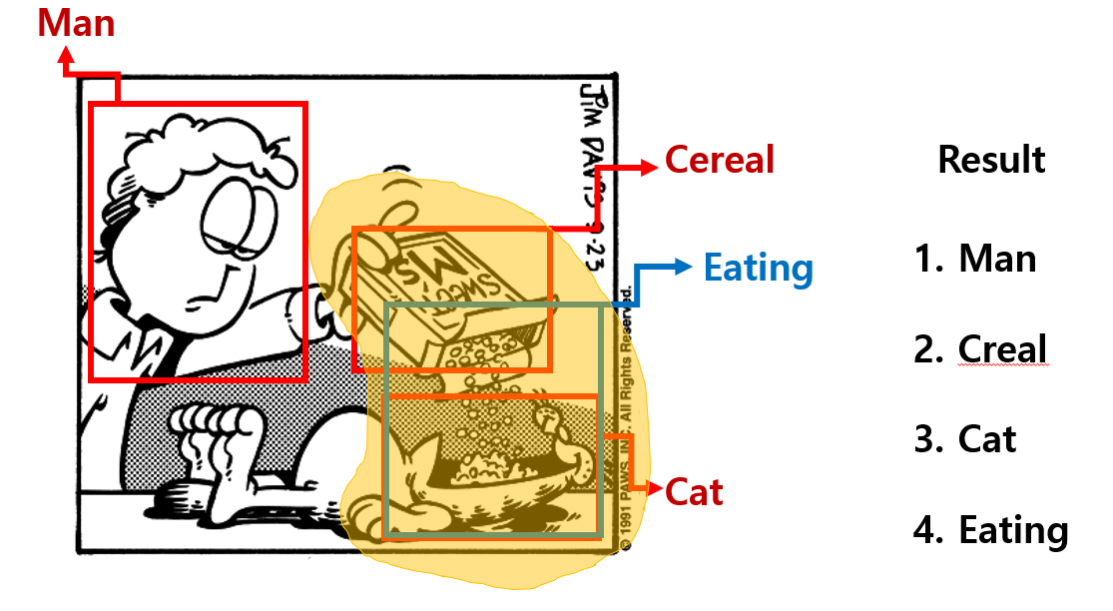

Slide 11

Method

Slide 12
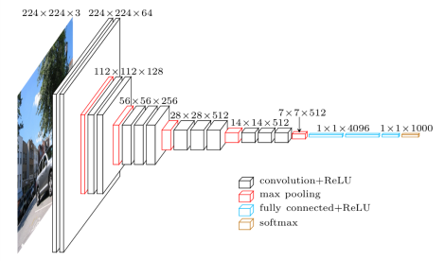
Method
Convolutional Neural Network (CNN)
Convolution
Max pooling
Convolution
Max pooling
Convolution
Max pooling
Fully connected
Softmax regression

Slide 13
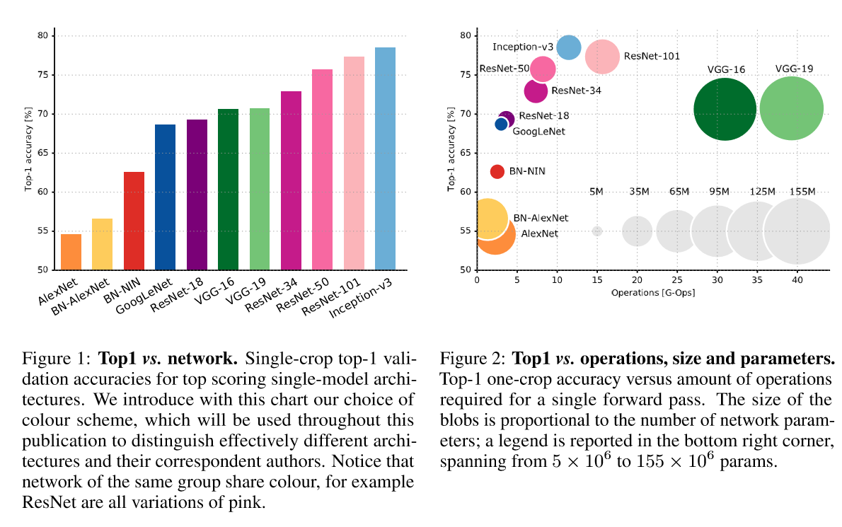
CNN Algorithm Comparison
There are many algorithm models: ResNet, InceptionV3, DenseNet, SqueezeNet etc.

Slide 14

Modeling

Slide 15
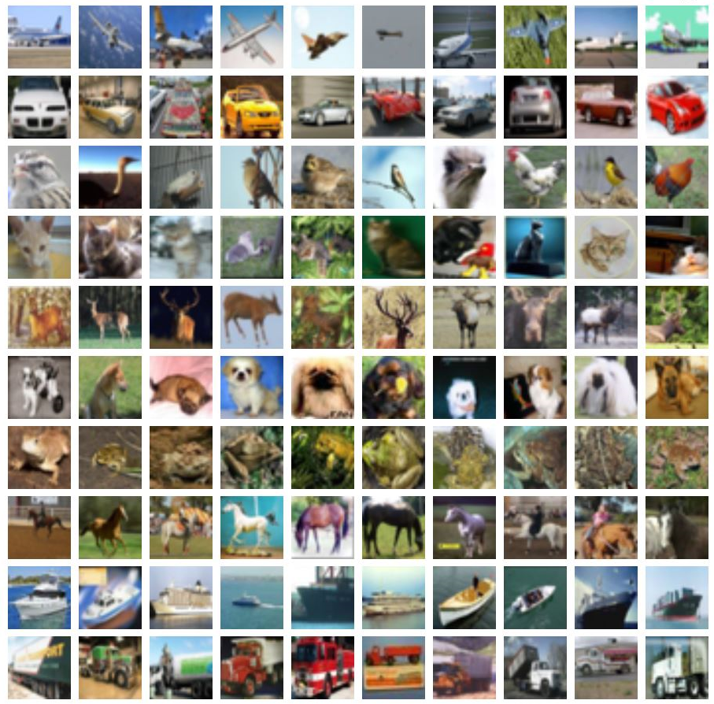
Modeling
Training Dataset
CIFAR-10 Datasets
Dog(50000)
Cat(50000)
Training
ResNet-50
InceptionV3

Slide 16
Modeling
Training

Slide 17
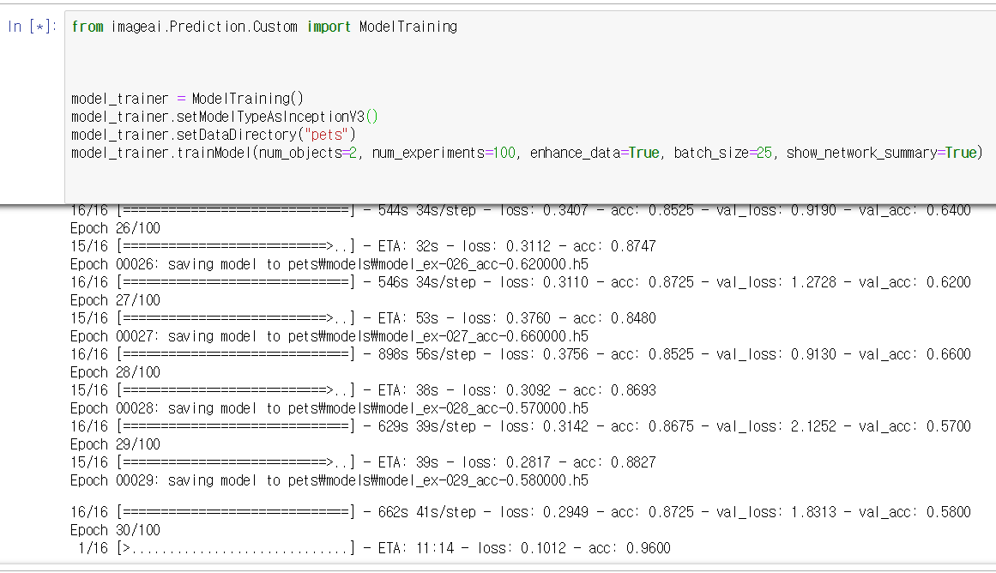
Modeling
Training

Slide 18

Conclusion

Slide 19
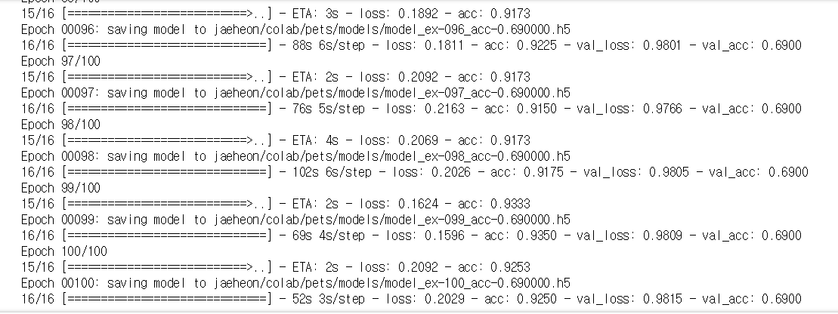
Conclusion
ResNet-50

Slide 20
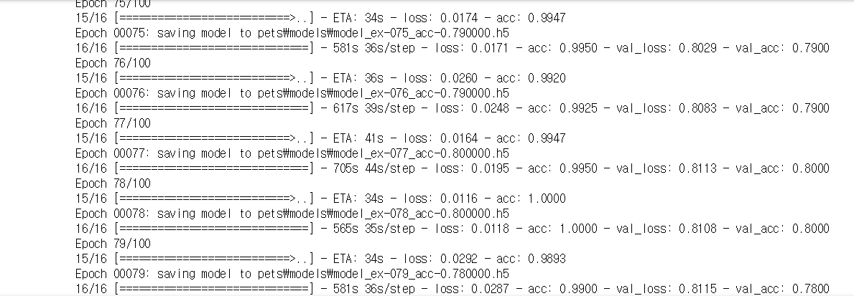
Conclusion
InceptionV3

Slide 21

Discussion

Slide 22
Discussion
Limitation & Suggestion
When trained by video to predicting the action using previous action.

Slide 23
THANK YOU

